Slide 1
Understanding How Dimension Reduction Tools Work: An Empirical Approach to Deciphering t-SNE, UMAP, TriMap, and PaCMAP for Data Visualization
Nov 23, 2021
Gwangwoo Kim

Slide 2
Contents
Introduction
Preliminary
Principles of a Good Objective Function for Dimension Reduction, Part I: The Loss Function
Principles of a Good Objective Function for Dimension Reduction, Part II: Graph Construction and Attractive and Repulsive Forces
The PaCMAP Algorithm
Numerical experiments
References

Slide 3
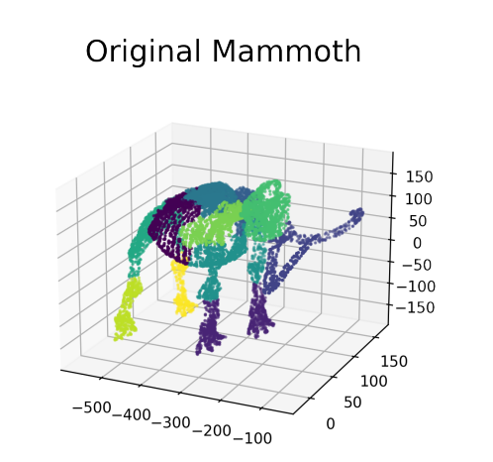
1. Introduction

Slide 4
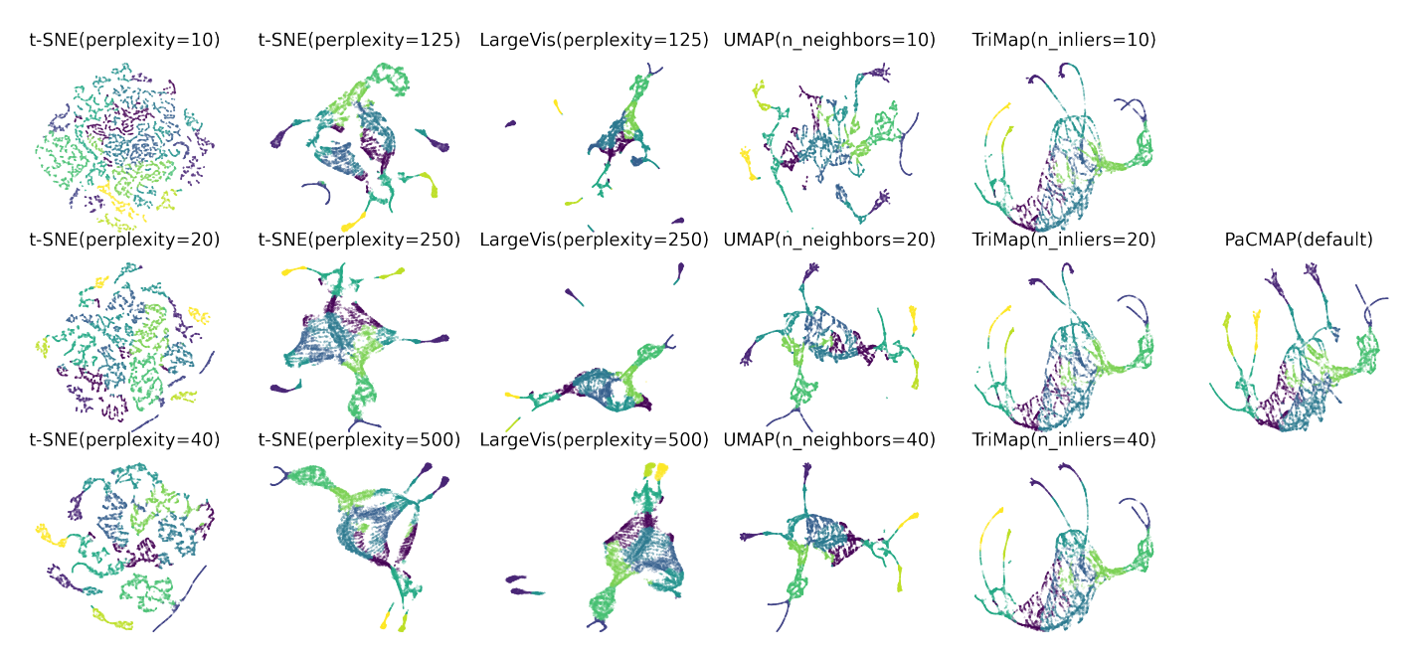
1. Introduction

Slide 5
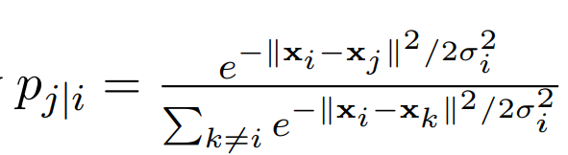
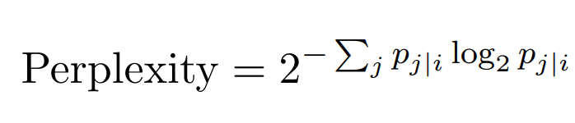
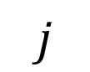
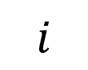
2. Preliminary: t-SNE
$$i$$
$$j$$

Slide 6
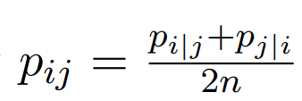
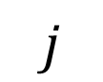
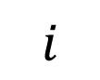
2. Preliminary: t-SNE
$$i$$
$$j$$

Slide 7
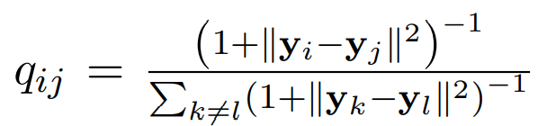
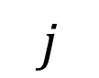
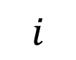
2. Preliminary: t-SNE
$$i$$
$$j$$

Slide 8
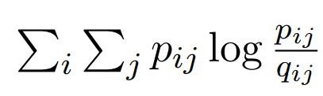
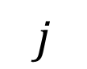
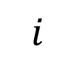
2. Preliminary: t-SNE
$$i$$
$$j$$

Slide 9
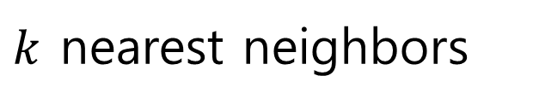
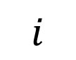
2. Preliminary: UMAP
$$i$$
$k$ nearest neighbors

Slide 10
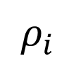
2. Preliminary: UMAP
$$ρ_{i}$$
$$i$$

Slide 11
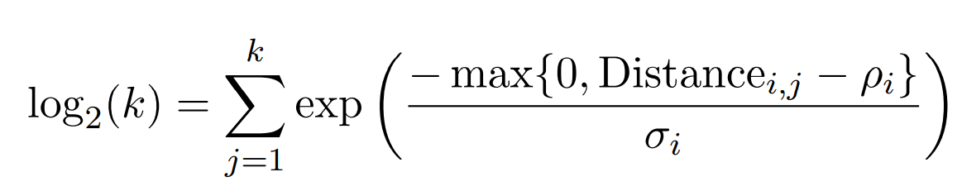
2. Preliminary: UMAP
$$i$$

Slide 12
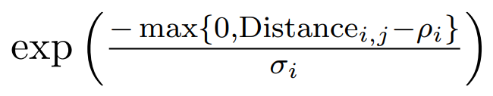
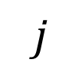
2. Preliminary: UMAP
$$j$$
$$i$$

Slide 13
2. Preliminary: UMAP
$$j$$
$$i$$

Slide 14
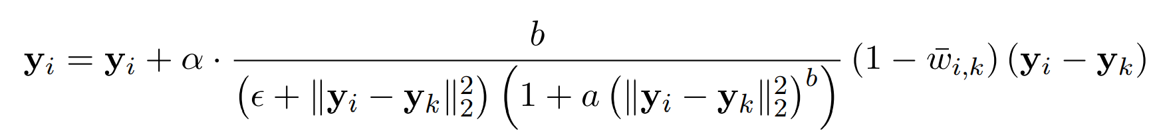
2. Preliminary: UMAP
$$j$$
$$i$$

Slide 15
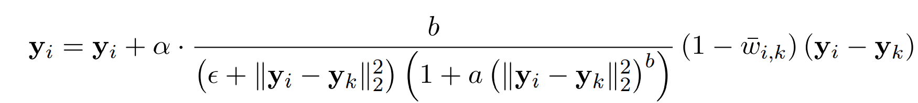
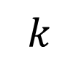
2. Preliminary: UMAP
$$k$$
$$j$$
$$i$$

Slide 16
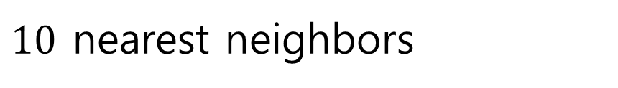
2. Preliminary: TriMap
$$i$$
$10$ nearest neighbors

Slide 17
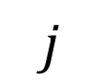

2. Preliminary: TriMap
$$k$$
$$j$$
$$i$$
Create 50 triplets $(i,j,k)$ per observation

Slide 18
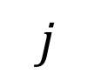
2. Preliminary: TriMap
$$k$$
$$j$$
$$i$$
Create 5 additional triplets $(i,j,k)$ per observation, randomly.

Slide 19
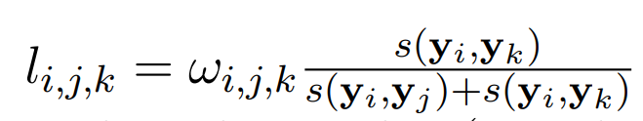
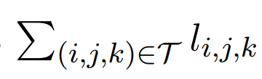
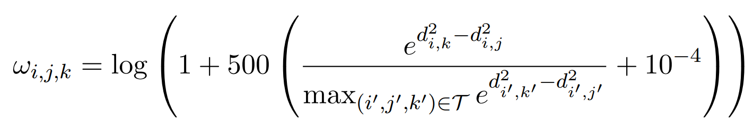
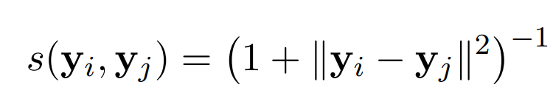
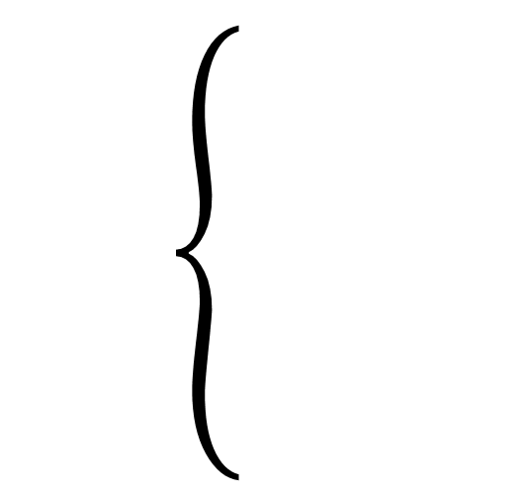
2. Preliminary: TriMap
Loss

Slide 20
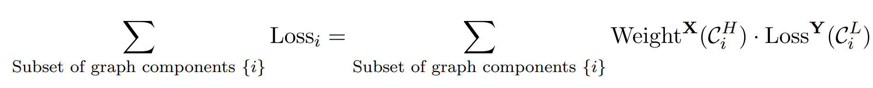
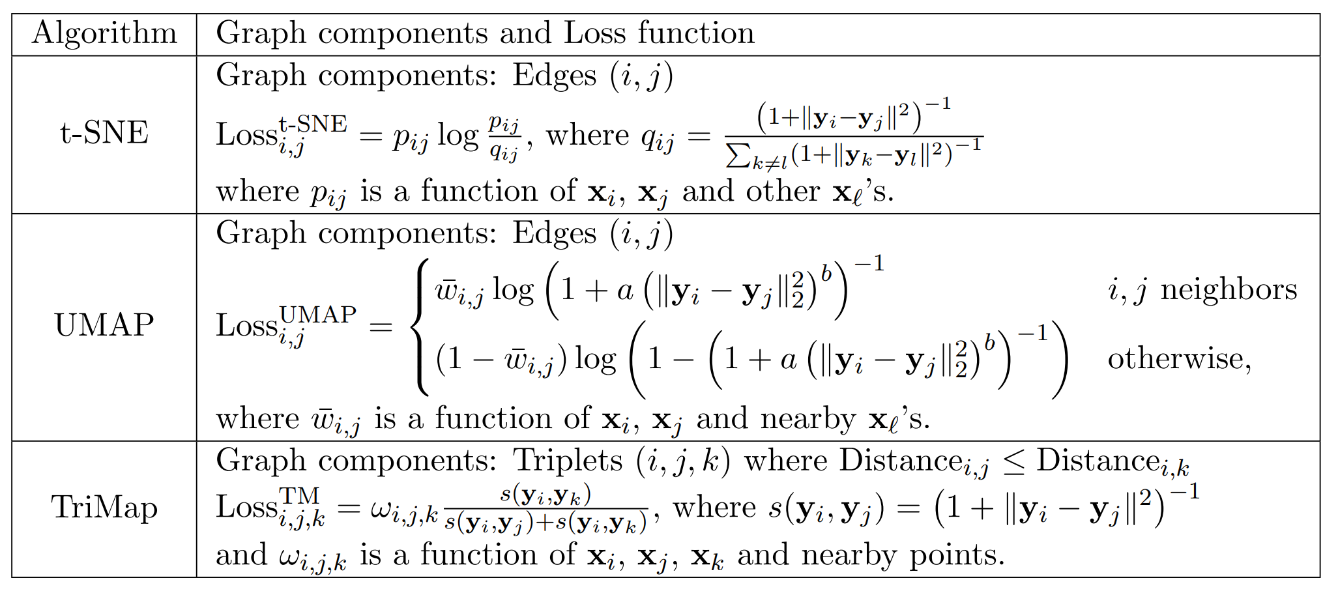
3. Principles of a Good Objective Function for Dimension Reduction, Part I: The Loss Function

Slide 21
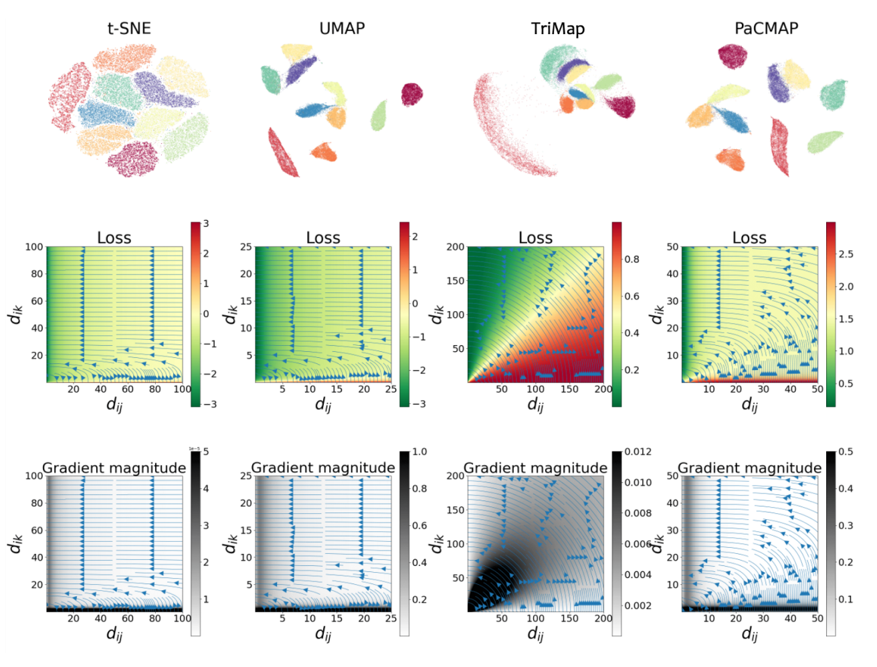

Slide 22
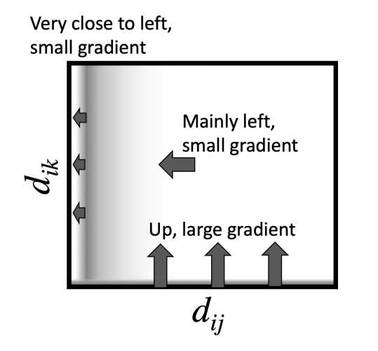
3. Principles of a Good Objective Function for Dimension Reduction, Part I: The Loss Function

Slide 23
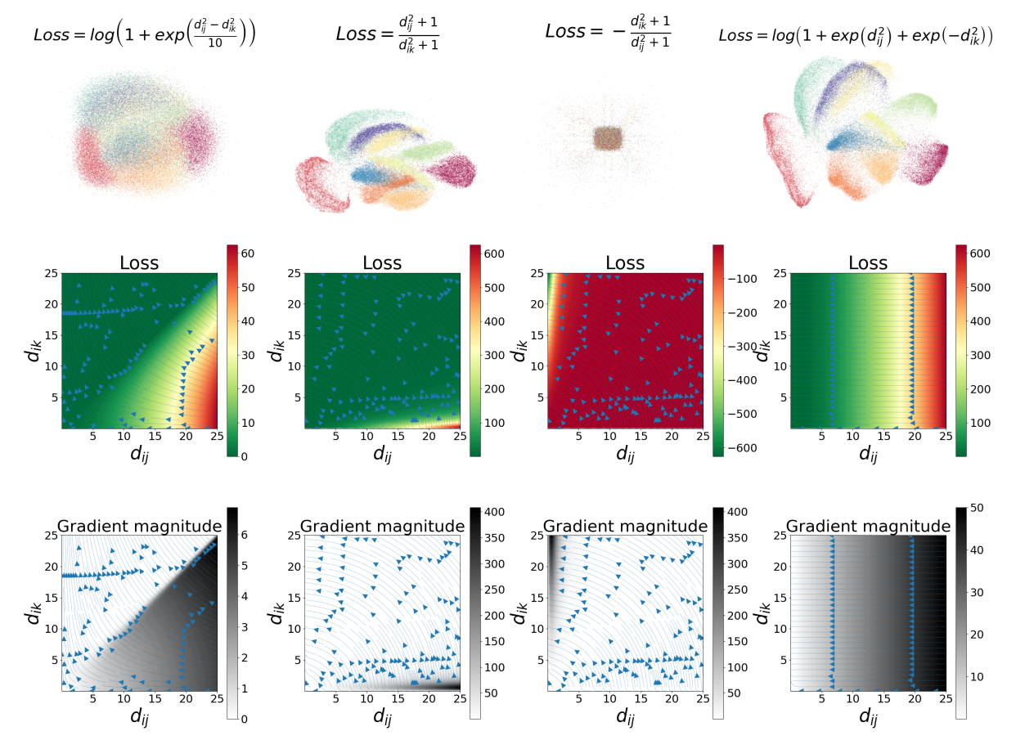

Slide 24
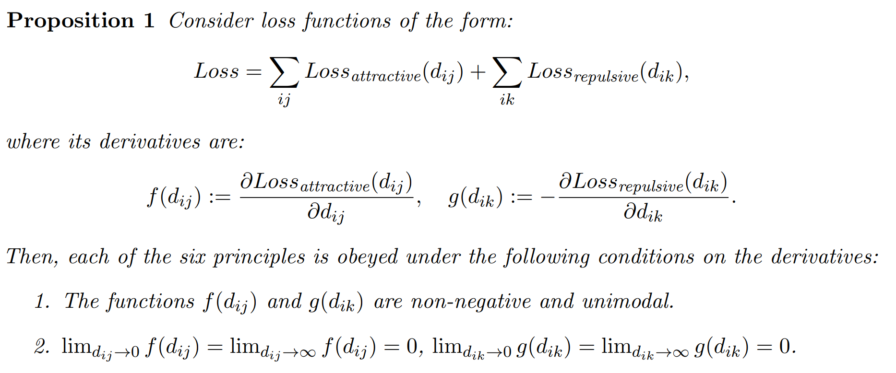

Slide 25
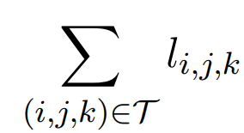
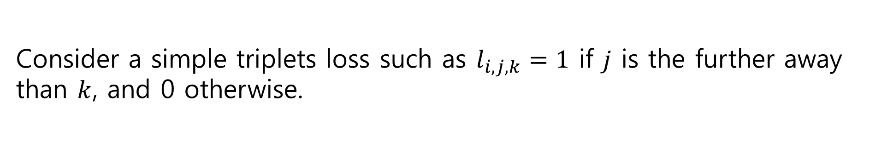
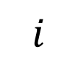
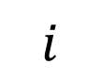
4. Principles of a Good Objective Function for Dimension Reduction, Part II: Graph Construction and Attractive and Repulsive Forces
Consider a simple triplets loss such as $l_{i,j,k}=1$ if $j$ is the further away than $k$, and 0 otherwise.
$$i$$
$$i$$

Slide 26
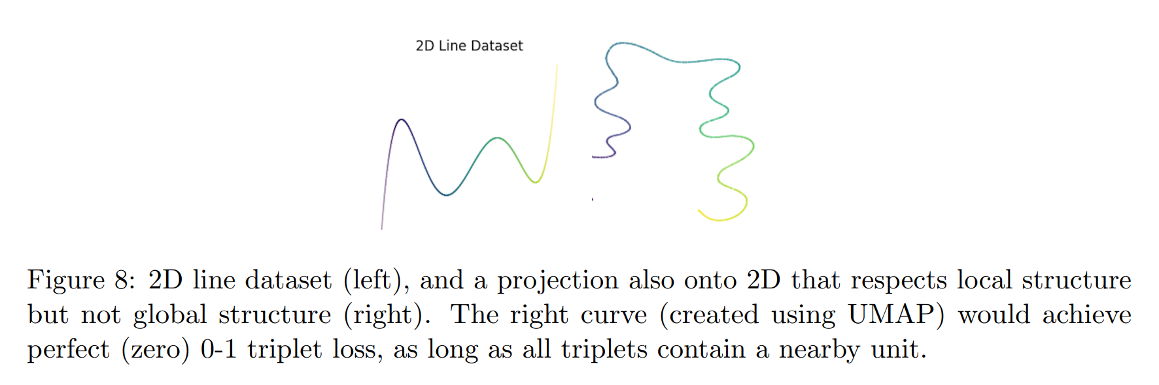
4. Principles of a Good Objective Function for Dimension Reduction, Part II: Graph Construction and Attractive and Repulsive Forces

Slide 27
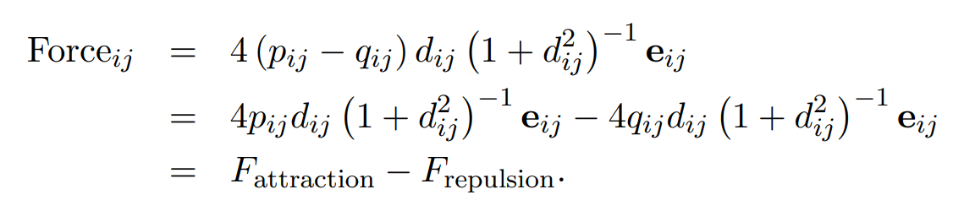
4. Part II: Graph Construction and Attractive and Repulsive Forces: t-SNE and UMAP

Slide 28
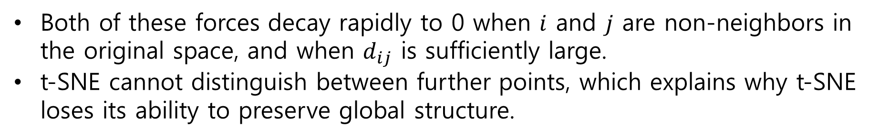
4. Part II: Graph Construction and Attractive and Repulsive Forces: t-SNE and UMAP
Both of these forces decay rapidly to 0 when $i$ and $j$ are non-neighbors in the original space, and when $d_{ij}$ is sufficiently large.
t-SNE cannot distinguish between further points, which explains why t-SNE loses its ability to preserve global structure.

Slide 29
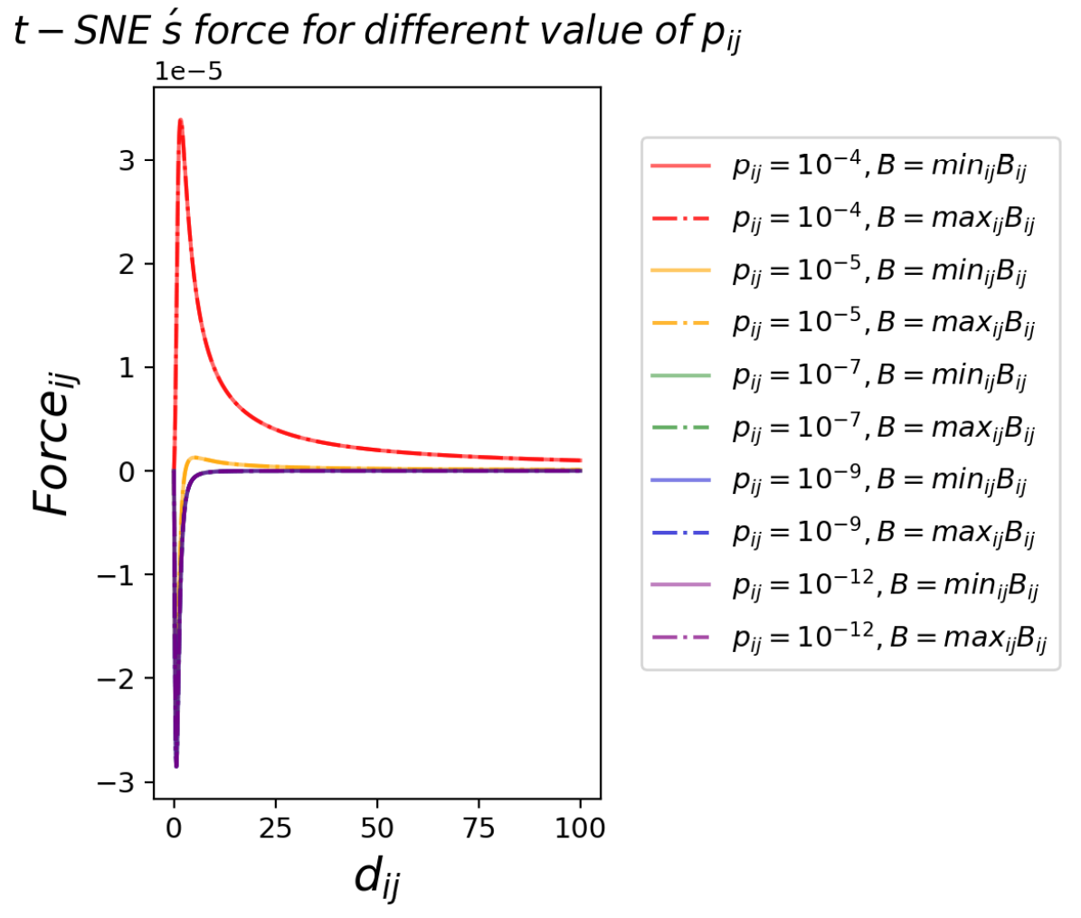

Slide 30
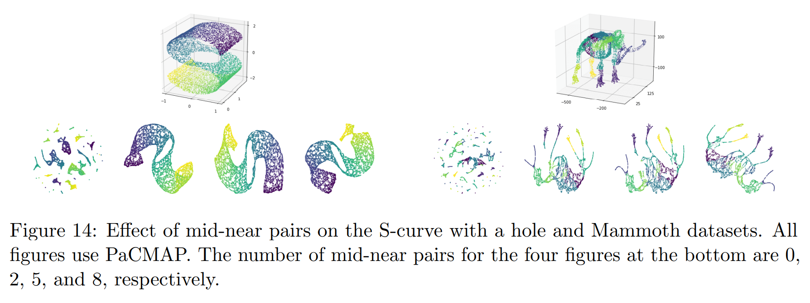

Slide 31
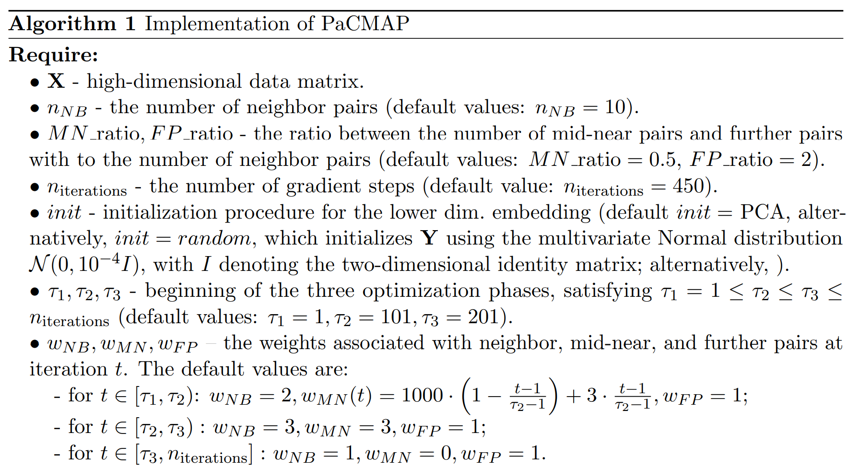
5. The PaCMAP Algorithm

Slide 32
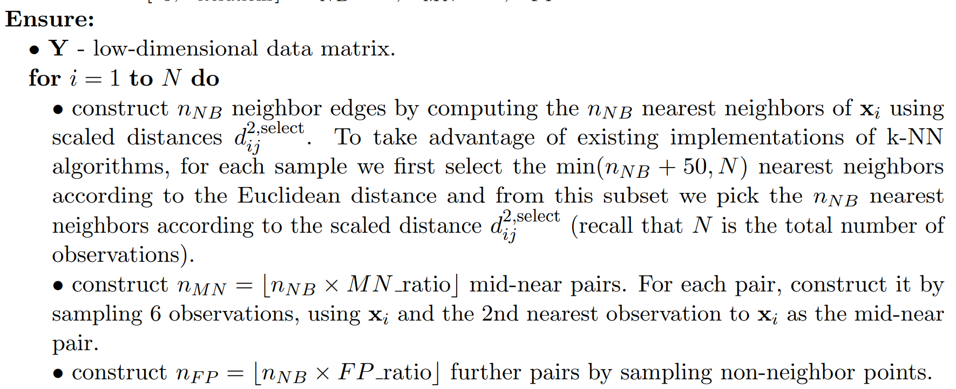
5. The PaCMAP Algorithm

Slide 33
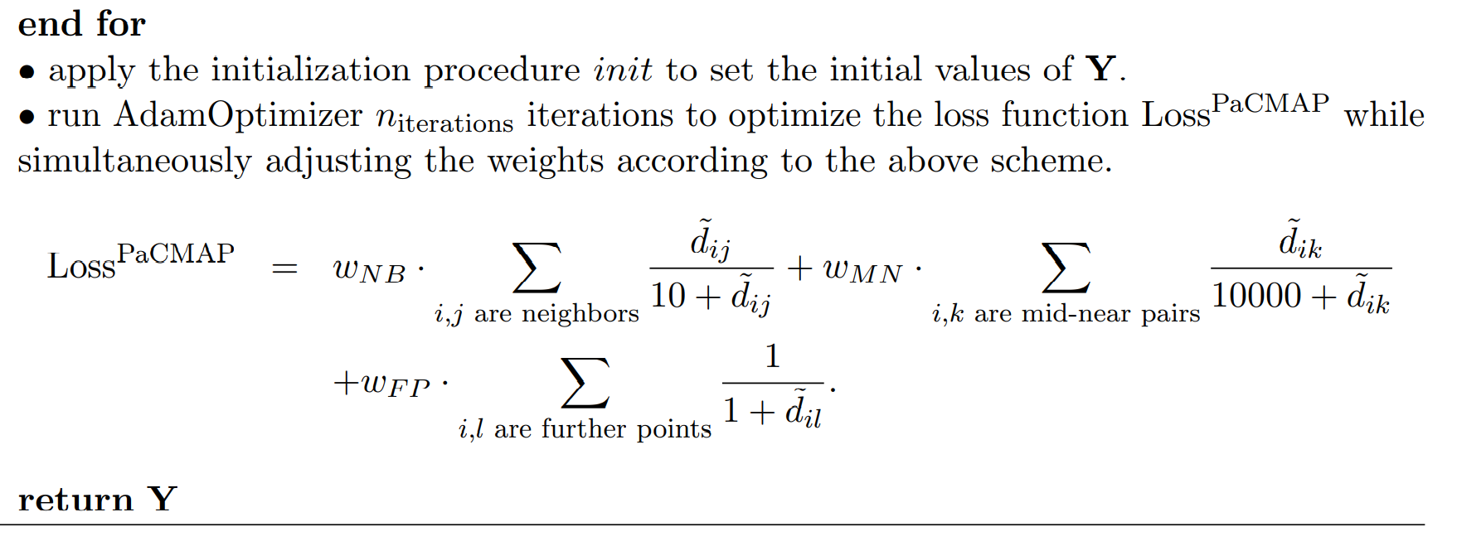
5. The PaCMAP Algorithm

Slide 34

6. Numerical experiments

Slide 35

6. Numerical experiments

Slide 36


6. Numerical experiments
SVM Accuracy
Random triplet accuracy

Slide 37

6. Numerical experiments

Slide 38
6. References
[1] Wang, Y., Huang, H., Rudin, C., & Shaposhnik, Y. (2021). Understanding how dimension reduction tools work: an empirical approach to deciphering t-SNE, UMAP, TriMAP, and PaCMAP for data visualization. Journal of Machine Learning Research, 22(201), 1-73.
[2] Ehsan Amid and Manfred K. Warmuth. TriMap: Large-scale Dimensionality Reduction Using Triplets. arXiv e-prints, art. arXiv:1910.00204, October 2019.

